Slide 1


INTERNATIONAL TRADE
ANALYSIS

Slide 2
OBJECTIVE
Analyse Global Trade and Identify Strategic Investment Opportunities
  What is happening in global trade, and how is it linked to economic prosperity?
  Which products and countries dominate global trade?
  Where should companies allocate their trade-related investments?
  What is the future outlook for the key countries targeted by investors?

Slide 3
ANALYSIS PROCESS
Data Collection
Data Preparation
Clustering
Forecast
World Bank Sources:
  ETL
  Transformations
  Cleaning
  Filtering
  World GDP
  Population
  Unsupervised Machine Learning
  K-means Clustering
  Supervised Machine Learning
  Linear regression
  Projected GDP for key countries to 2028
WTO Stats Sources:
  Global Exports Data
  Global Imports Data
  Avg tariff rates
  FDI inflows
18 Product Categories
164 countries
2005–2023

Slide 4

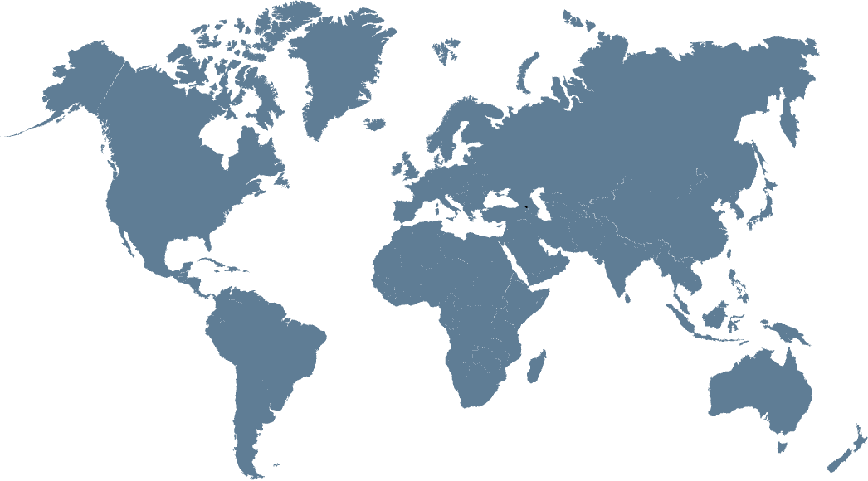
THE GLOBAL PICTURE
QUESTION 1: WHAT IS HAPPENING IN GLOBAL TRADE, AND HOW IS IT LINKED TO ECONOMIC PROSPERITY?
47.16 Trillion USD
Total trade in 2023 :
Global trade has expanded steadily since 2005, with only temporary setbacks during major crises.
-463.17 Billion USD
Trade Balance in 2023 :
Global exports and imports are closely balanced, with a small trade deficit of about 0.5 Trillion in 2023.
3.08%
World GDP Growth Rate in 2023 :
Global trade has recovered from recent shocks but is now supporting a slower, more moderate phase of economic prosperity

Slide 5

QUESTION 1: WHAT IS HAPPENING IN GLOBAL TRADE, AND HOW IS IT LINKED TO ECONOMIC PROSPERITY?
Balanced trade structures support stability
More open economies are richer
Trade and GDP move together
High tariffs constrain prosperity

Slide 6

QUESTION 2: WHICH PRODUCTS AND COUNTRIES DOMINATE GLOBAL TRADE?
  A small club of economies dominates both sides of trade
  Country specialization aligns with product dominance
  Manufactured goods dominate global trade baskets
EXPORT
Top 5 Categories
IMPORT
Top 5 Categories
  Agricultural Products
  Food
  Manufactures
  Machinery
  Mining Products & Subsidiaries
  Manufactures
  Machinery
  Transport equipment
  Mining Products & Subsidiaries
  Fuels

Slide 7
QUESTION 3:
Where should companies allocate their trade-related investments?

Slide 8
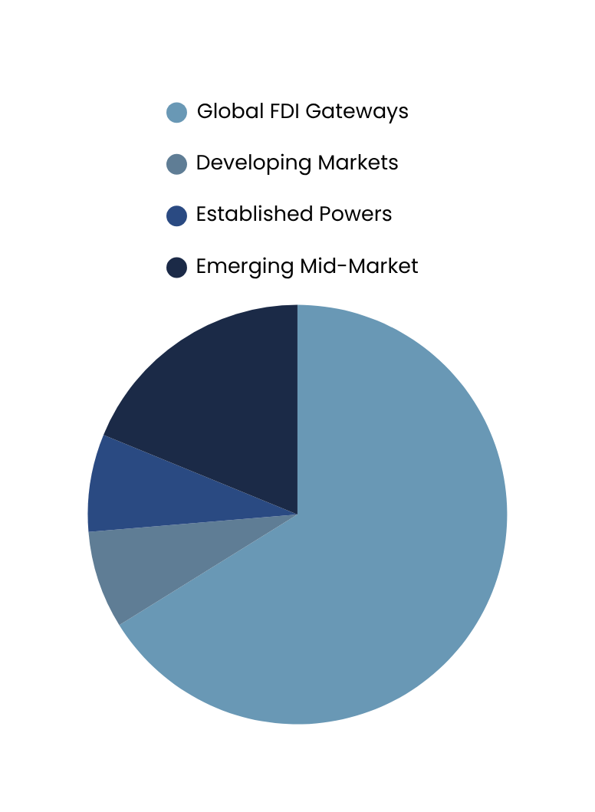
K-MEANS CLUSTERING : 4 COUNTRY TYPES
Developing Markets
Global FDI Gateways
Established Powers
Emerging Mid-market
Low-income high tariffs
Weak FDI
Small but highest FDI inflows
Mature, low-risk developed markets
Well-built economies with strong upsides
18%
88 Countries
10 Countries
10 Countries
24 Countries
8%
8%
66%
Silhouette score: 0.5
Input Features:
  FDI
  HHI
  Population
CAGR (5yr growth)
GDP per capita
Average Tariff
Total Countries Clustered: 132

Slide 9





QUESTION 3: WHERE SHOULD COMPANIES ALLOCATE THEIR TRADE-RELATED INVESTMENTS?
INVESTMENT SCORE
Top 5 Investment Destinations – Machinery
Constructed by normalizing six indicators
  Imports
  Exports
  GDP
  HHI
  Tariffs
  FDI
Higher scores indicate countries with stronger overall fundamentals and better investment attractiveness.
Hungary
0.69
Singapore
0.68
Mexico
0.67
Slovak Republic
0.67
Hong Kong, China
0.66

Slide 10
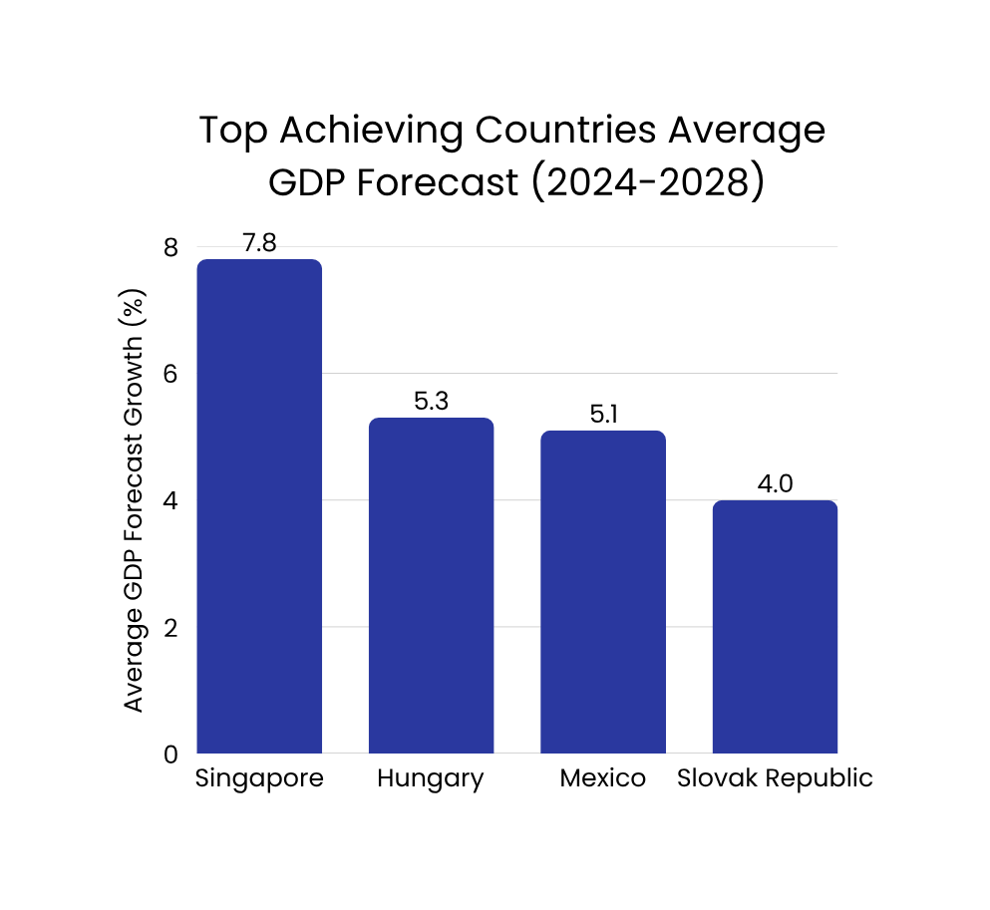
QUESTION 4: WHAT IS THE FUTURE OUTLOOK FOR THE KEY COUNTRIES TARGETED BY INVESTORS?
Supervised Machine Learning: Linear Regression
High-Score Trap
Highest-rated markets show moderate growth
Priority Markets
Countries combining strong fundamentals with strong momentum.
High
GDP
Optional Growth
Markets
Priority Markets
Stable Core Markets
Advanced, steady economies with strong fundamentals.
Optional Growth Markets
Deprioritized Markets
Stable Core Markets
Countries showing fast improvement from a lower base.
Deprioritized Markets
High
Low
Investment Score
Countries with weaker fundamentals and limited near-term momentum.

